Slide 1
DMU380 SW Review
For 7/01/13

Slide 2
Agenda
System configuration
SW block diagram
Synchronous sampling
How each sensor gets sampled
Data acquisition timeline
Latency
OS Tasks
Code organization
Data acquisition
Debug interface
UCB interface
Packets
Demo!
SPI interface
Remaining DMU380 tasks
Development schedule

Slide 3
System Configuration
Output data rate: 400Hz
SPI or serial (i.e. RS232) options
Accelerometer options: 2, 4, or 8G
Rate options: 250 or 400 deg/sec
Mag options: range from 0.88 to 8.0 Gauss
Sensor range is factory configurable
Can make output data rate user configurable

Slide 4
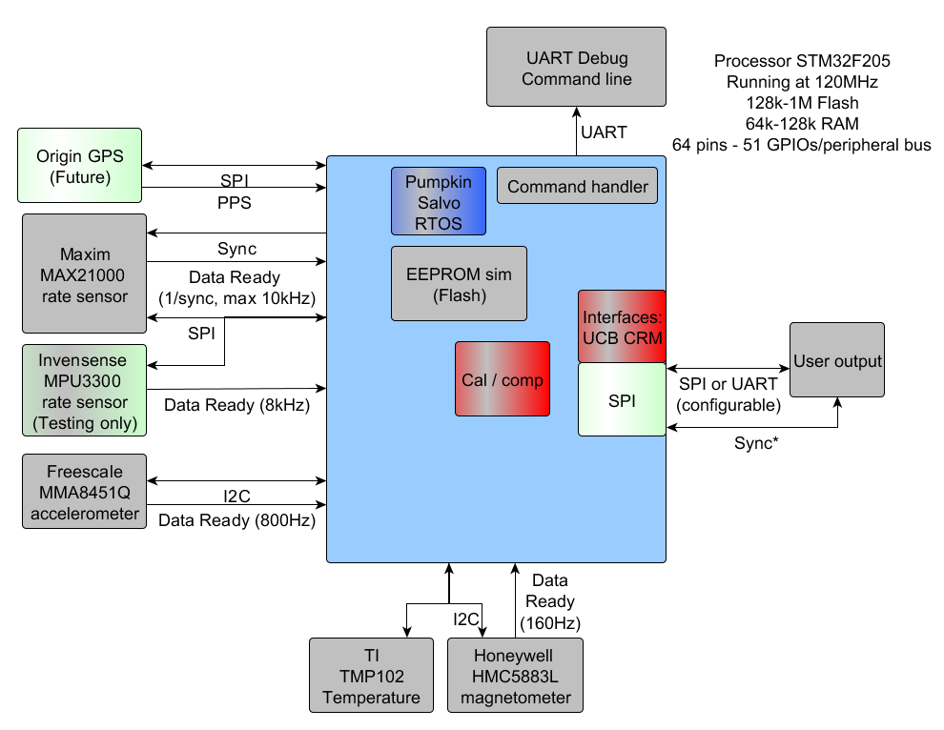
SW block diagram

Slide 5
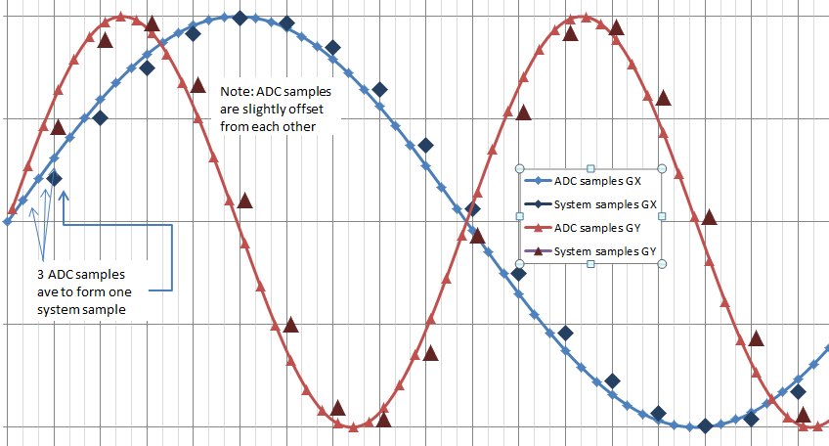
Sampling methods: 440
Analog sensor connected to an ADC, which samples the signal as fast as it can; SW accumulates the data. Each system sample is formed from the accumulated data divided by number of samples (an N-point average).

Slide 6
Sampling: MAX21000 (Rate Sensor)
Processor controls sample start of rate sensor.
Timer interrupt (TIM5)
Assert rate sensor sync line
Rate sensor does conversion
Data ready interrupt
Read data (SPI, DMA)
OS signal RATE_READY
Task data acquisition
Internally, the MAX21000 samples at 10kHz. It is very likely the chip begins averaging the 10kHz samples when the sync is received (similar to the 440); data is output when it accumulates sufficient samples to provide data at a 400Hz rate.

Slide 7
Sampling: MMA8451Q (Accelerometer)
The accelerometer lacks a sync line. It can output at 800Hz (or 400Hz) but the signal is asynchronous to the rate sensor sampling.
Accelerometer samples are accumulated (in an interrupt) at 800Hz. When the system is ready to proceed, the data is averaged to form a system sample.
Note: if the system is running at 400Hz, 1-3 individual accel samples are averaged to form a system sample.
Data Acquisition
Interrupt
Timer interrupt (TIM5)
Clear accumulation buffer
Wait for RATE_READY & ACCEL_READY
Task data acquisition
Average accumulation buffer
Accelerometer
Data Interrupt
Data ready interrupt
800Hz
Read data (I2C)
Accumulate date
OS signal ACCEL_READY

Slide 8
Sampling: MPU3300 (Rate Sensor)
The Invensense rate sensor also does not have a sync line. The process is very similar to the accelerometer but the data is at 8kHz instead of 800Hz so more sensor samples are accumulated between system samples.
Note: if this gyro is the target, the timer interrupt needs to signal the accel and gyro to be finished.
MPU3300 is for risk mitigation

Slide 9
Sampling: HMC5883L (Magnetometer)
Maximum output rate of 160 Hz (asynchronous with other inertial sensors). Data is picked up as it is available; previous sample is used until new is available.
Timer interrupt (TIM5)
If mag was finished, start new sample
Data ready interrupt
Read data (I2C)
OS signal MAG_READY
Task data acquisition

Slide 10
Sampling: TMP102 (Temp Sensor)
System temperature will change slowly
Data is sampled at 1Hz (similar to manner in which magnetometer data is acquired)

Slide 11
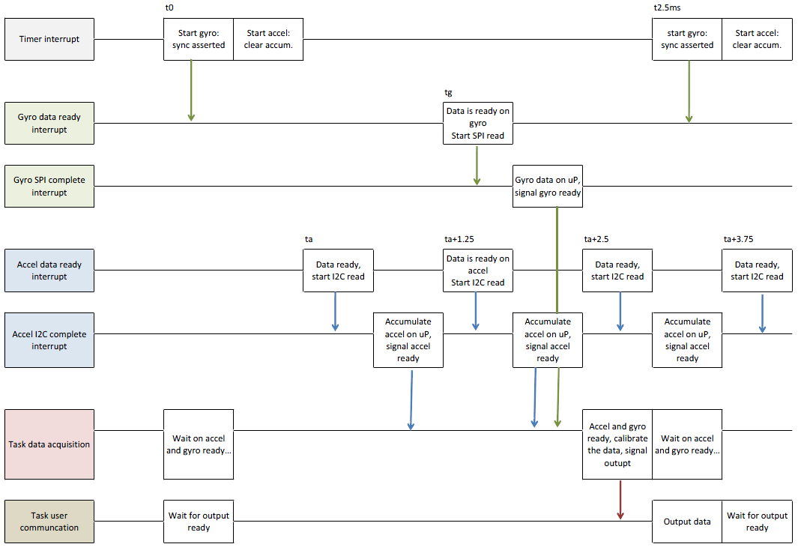
Data Acquisition Timeline

Slide 12
OS Tasks
Task | Run at | Priority | Notes
Acquire sensor data, apply calibration | 400Hz | 1
Process user (and debug) commands | (Whenever RX interrupt occurs) | 2
Update calibration data (temperature data) | 1Hz | 3 | (Not implemented.) ??
Calculate angles (nav) | 200Hz | 4 | (Not implemented.)
Position, velocity, Kalman error calculation | 100Hz | 5 | (Not implemented.)
GPS processing, correction calculation | 1-10Hz | 7 | (Not implemented.)
Heartbeat | ~7Hz | 14 | Toggles GPIO.
World magnetic model | Any free time | 15 | Update every 10 min (Not implemented.)
OS idle | Any leftover time | 16

Slide 13
Code Organization: Data
Data Acquisition
Timer Interrupt
Rate
Temp
Mag
I2C
Accel
Data ready
Data ready
SPI
Data ready
Calibration and compensation
EEPROM in Flash

Slide 14
Code Organization: Debug Interface
Details:
- Serial port settings: 921600 baud, 8-bit, no parity, 1 stop-bit, no flow control (baud may vary based on need)
- Facilitates test-driven development: each part of the system tested during bring up. Each sensor can be polled (individually), configured, re-initialized, ...
- Represents the developer’s interface: used before SPI and standard UART are ready.
TaskCommandLine
Command handler (table)
Debug USART
g
gf
a
af
Accel
Rate
…
…
…

Slide 15
Code Organization: XBOW Interface
TaskUserCommunication
ProcessUcbCommands
ProcessCrmPort
ProcessContUcbPkt
ProcessDiagOutput
… A LOT OF CODE …
User UART
Emulating 440/525 interface:
Works with Nav-View
Uses configurator to program on-board flash*

Slide 16
Current Packet Status: UCB
Working | Untested | Future
Ping, echo, get packet, NAK | Program, software, algorithm reset | AngleU, Angle0, Angle1, Angle2, Angle4 (which?)
Get, set, read, write fields | Write cal | Scaled2
Read, write, unlock EEPROM | Test0, Test1 | Mag cal1, 3
ID, version, version all data
Scaled0, Scaled1, Factory1, Factory2

Slide 17
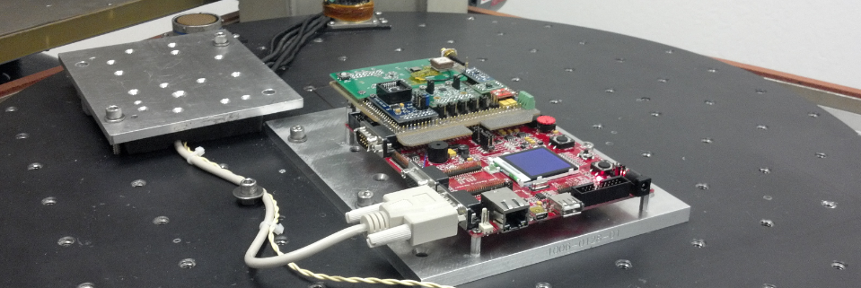
Demo!
Prototype operates with Nav-View to see system output packets (sensor data). The system already (kind of) works. And did you see all the wires? There are a lot of wires (also you should see Ed’s board because it is much prettier.)

Slide 18
Code organization: SPI Interface
TaskUserCommunication
Register based Interface
SPI
Much work still a lot to be done here:
Interface definition is about 30% complete
Interface code to be written
SPI driver should be straightforward (there is already SPI driver in the code)

Slide 19
Remaining DMU380 Tasks
Complete SPI interface (new) and other side of comms
Review 440 configurator, intended configuration
Improve error handling (I2C and SPI timeouts)
Finish calibration support (misalign and orient)
SW in place but untested
Test firmware update
Board bring-up of DMU380 proto-build
Mostly minor differences
Documentation
Determine if Q math is necessary

Slide 20
Development Schedule
IMU: Aug 30, 2013 (2 months)
Finalize IMU SW and complete algorithm testing
Complete SPI interface and output-packet development
Develop calibration process and SW implementation
VG: Sep 30, 2013 (1 month)
Finalize VG SW and complete algorithm testing
Complete SPI interface and output-packet development
AHRS: Oct 30, 2013 (1 month)
Finalize AHRS SW and complete algorithm testing
Complete SPI interface and output-packet development
INS: Jan 30, 2013 (3 months)
Implement GPS interface
Complete INS algorithm development
Finalize INS SW and complete algorithm testing
Complete SPI interface and packet development

